Slide 1


Lesson 19 Getting ready for a trip
UNIT 4

Slide 2

Do you travel often? How often would you like to travel?
How do you pack a suitcase?
Do you have a packing list?
What’s on your list?
Are any of the following words on your list?
T-shirt underwear
trainers pullover
flip-flops bikini
anorak camera
toothbrush elastic bands
jeans socks
cardigan Doc Martens
shorts wellies
hairbrush lip gloss
battery charger

Slide 3
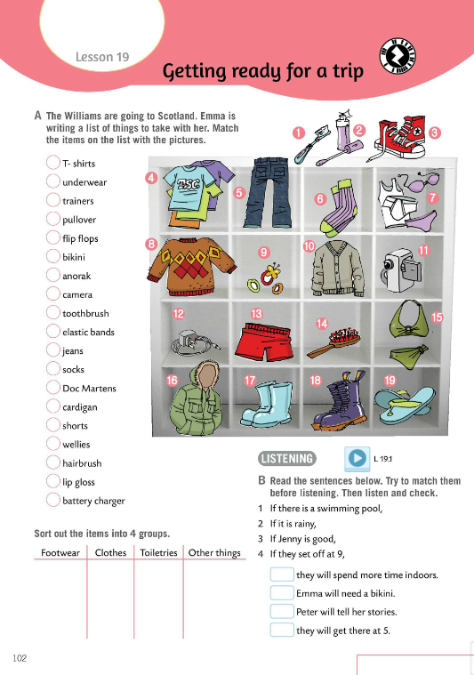
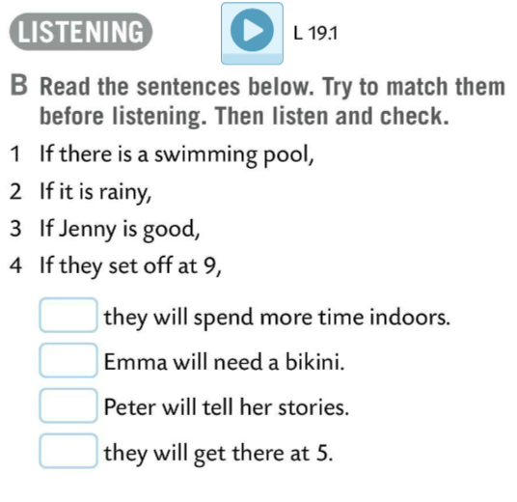
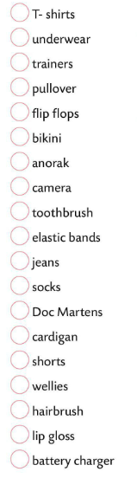
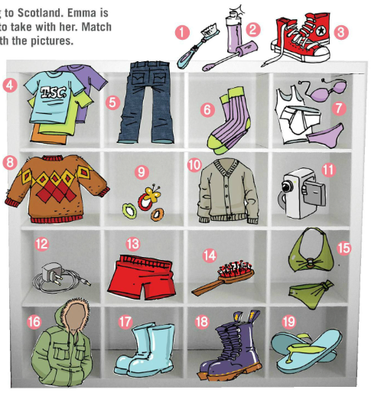
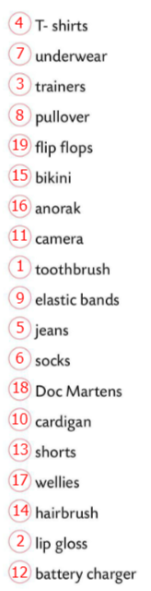
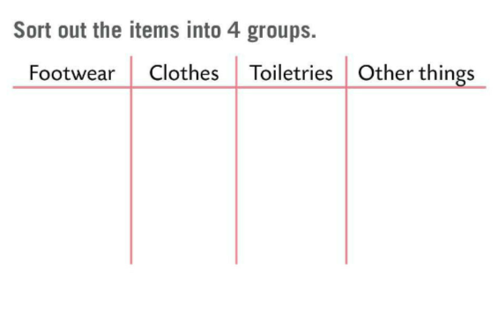

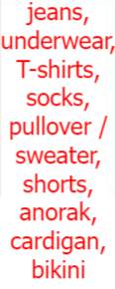
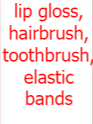



The Williams are going to Scotland. Emma is writing a list of things to take with her.
Match the items on the list with the pictures.
Check.
Sort out the items into 4 groups.
Check.
Read the sentences below. Match them.
Listen and check.

Slide 4
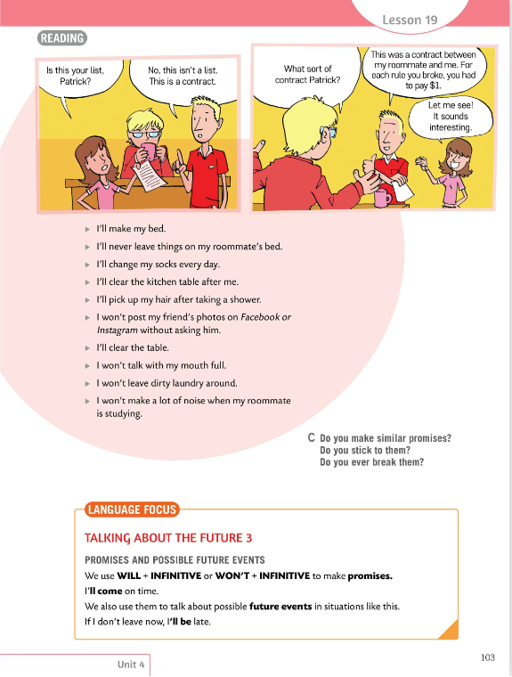
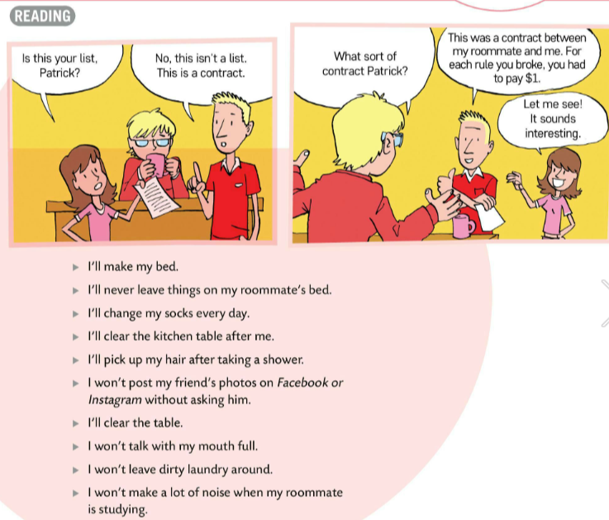
Translate:
contract – ugovor
sign a contract – potpisati/sklopiti ugovor
stick to the rules/a contract
– poštivati pravila/držati se ugovora
break a rule/a contract
– prekršiti pravila/ ugovor
Do you make similar promises?
Do you stick to them?
Do you ever break them?

Slide 5
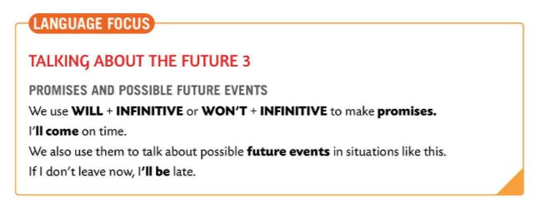
LANGUAGE FOCUS
- possible future events and promises
WILL + INFINITIVE
WON’T + INFINITIVE
I’ll come on time.
possible future events
If I don’t leave now, I’ll be late.

Slide 6
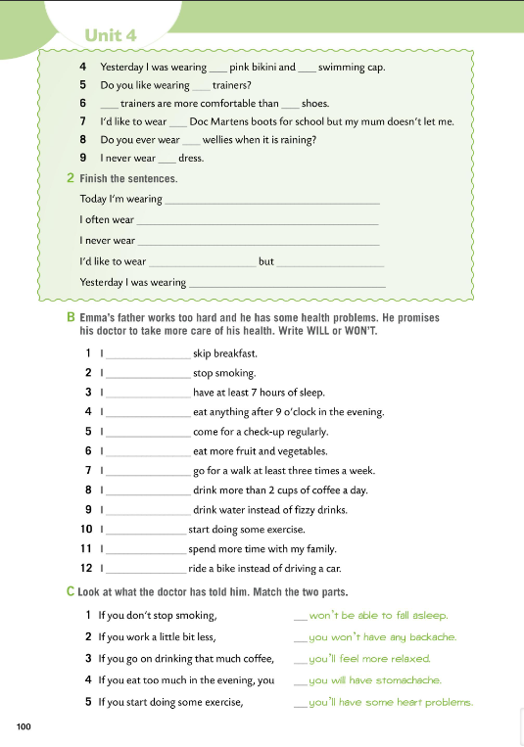

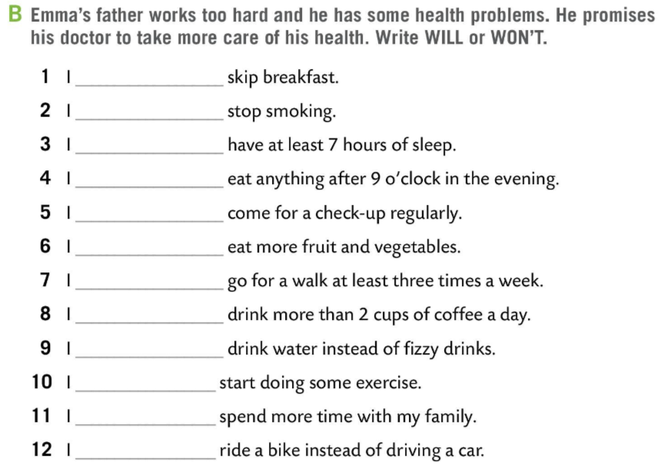
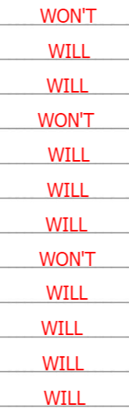
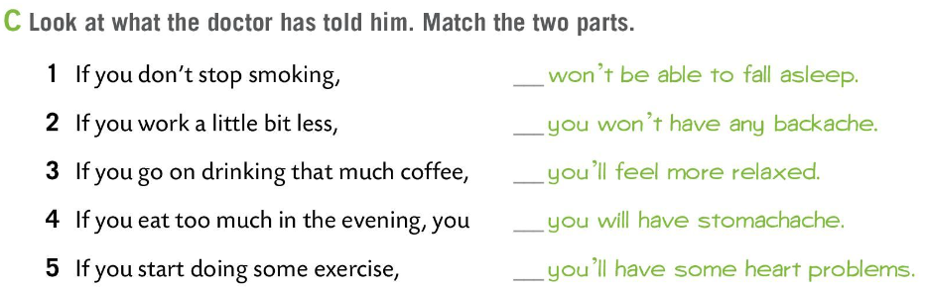
Workbook page 100.
Emma’s father works too hard, and he has some health problems. He promises his doctor to take more care of his health.
Write WILL or WON’T in Task B.
4
5
Check.
2
3
1
Look at what the doctor has told him. Match the two parts in Task C.
Check.

Slide 7
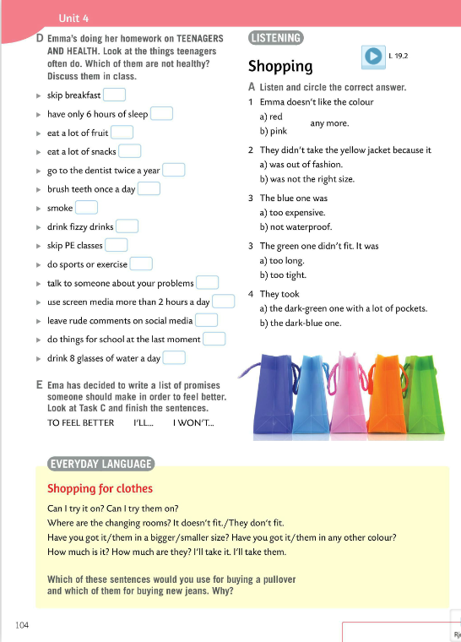
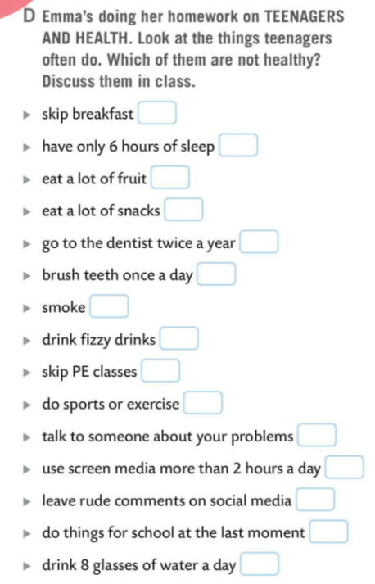
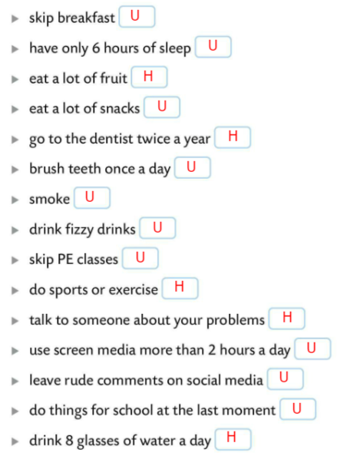
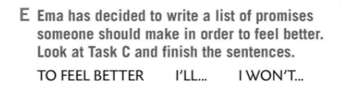
Emma’s doing her homework on TEENAGERS AND HEALTH.
Look at the things teenagers often do.
Which of them are not healthy?
Discuss them in class.
Write H for healthy and U for unhealthy.
Check.
Emma has decided to write a list of promises someone should make in order to feel better.
Look at Task C and finish the sentences.
Check sentences in class.

Slide 8
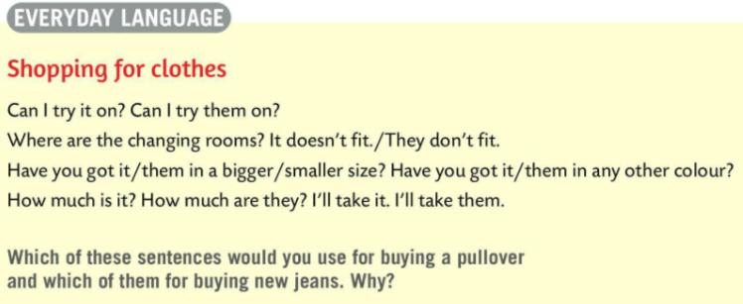
EVERDAY LANGUAGE
We use following expressions when we go shopping for clothes:
Can I try it on? Can I try them on?
It doesn’t fit. / They don’t fit.
Have you got it / them in a bigger/smaller size?
Have you got it / them in any other colour?
How much is it? How much are they?
I’ll take it. I’ll take them.
We use IT with countable nouns and THEY with uncountable nouns.
For example:
I like these jeans (U). Can I try them on?
I like this skirt (C). Can I try it on?

Slide 9
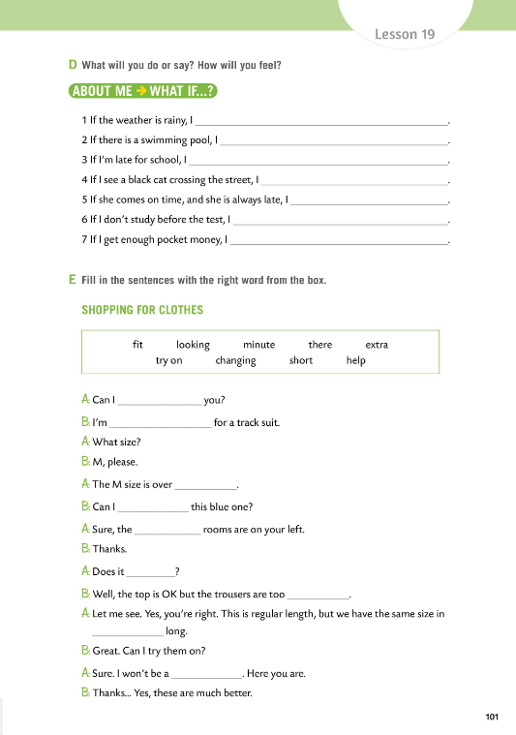
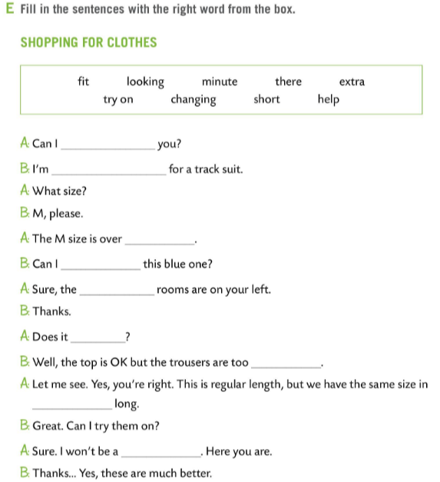
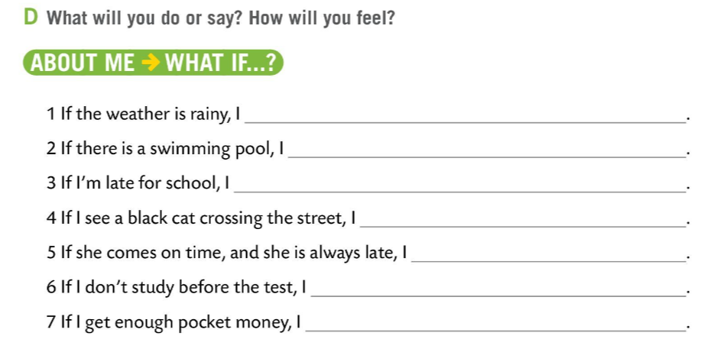
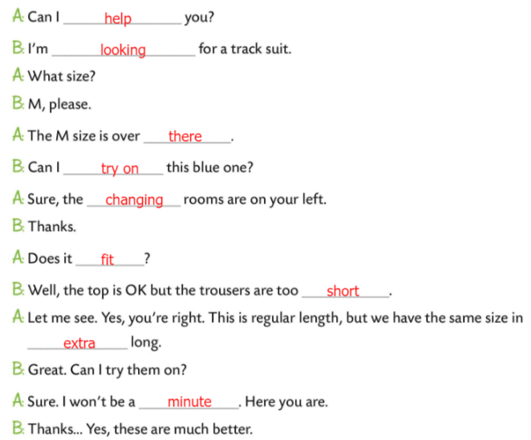
Workbook page 101.
What will you do or say? How will you feel?
Finish the sentences in Task D.
Fill in the sentences in Task E with the right word from the box.
Check.

Slide 10
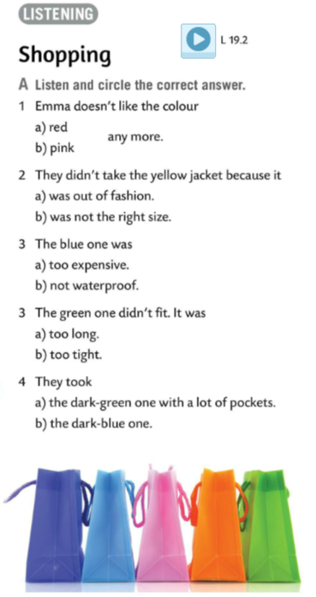
Listen and circle the correct answer in Task A.
Check.
Play a game. https://wordwall.net/play/511/200/183

Slide 11
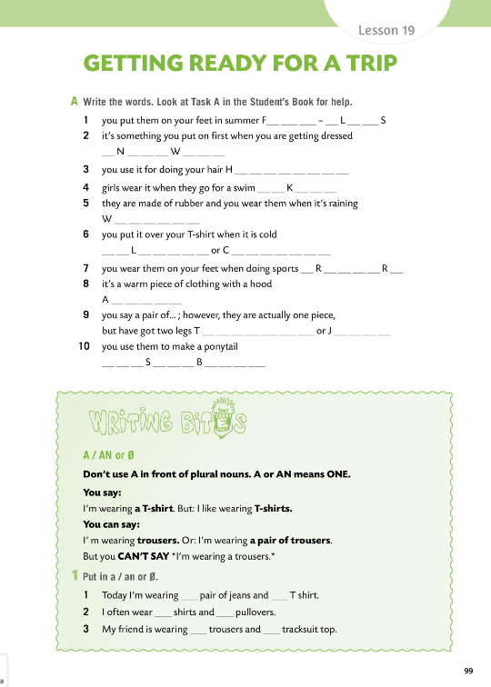
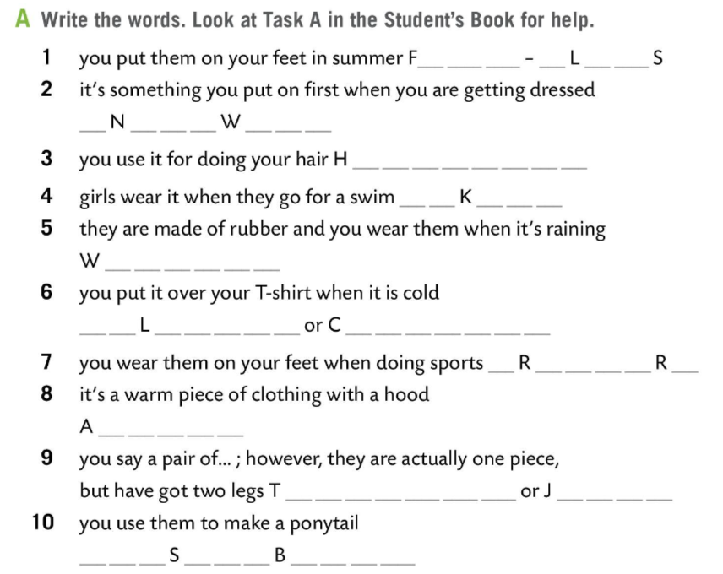
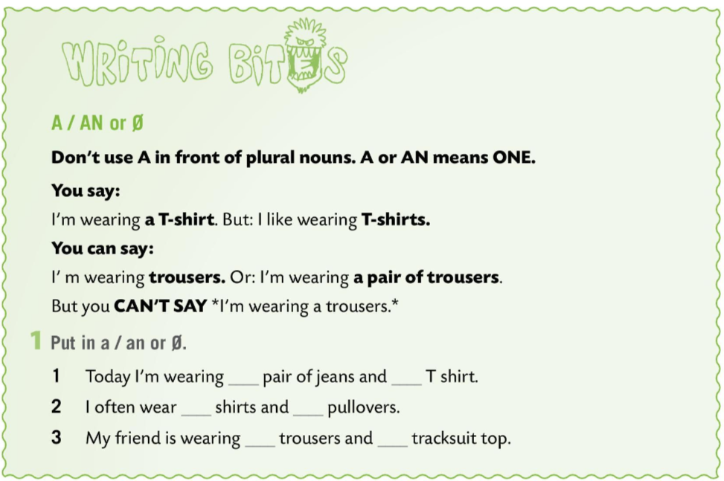
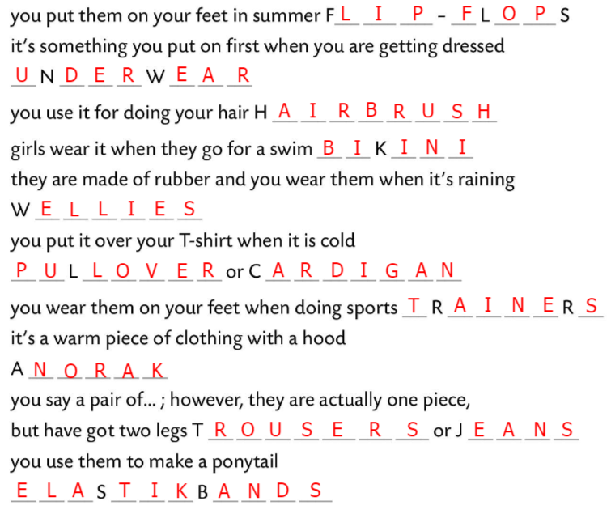
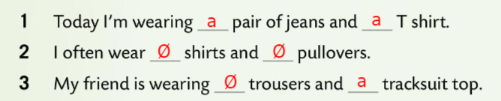
Workbook page 99.
Write the words in Task A.
Look at Task A in Student’s Book for help.
Check.
WRITING BITES
We don’t use A in front of plural nouns because A or AN means ONE.
I am wearing a skirt. BUT: I like wearing skirts.
I am wearing trousers. OR: I’m wearing a pair of trousers.
You CAN’T SAY: I’m wearing a trousers.
Put in the correct article in Task 1.
Check.

Slide 12
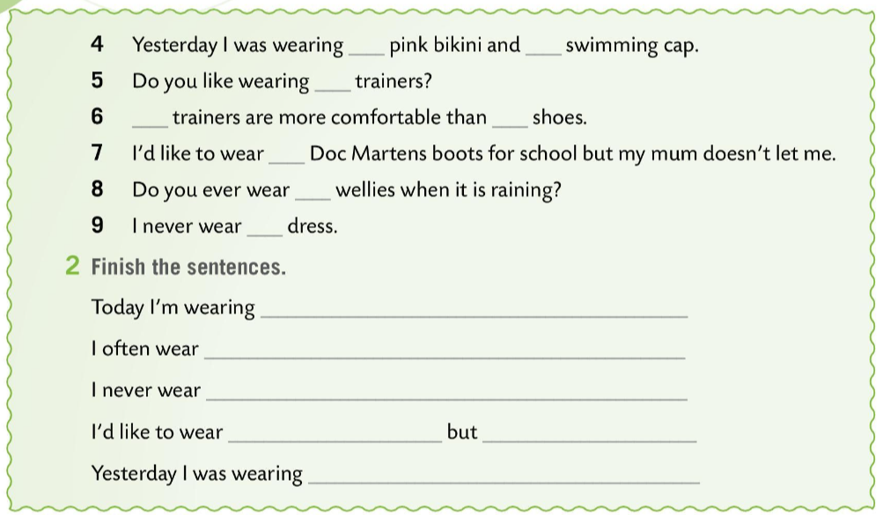
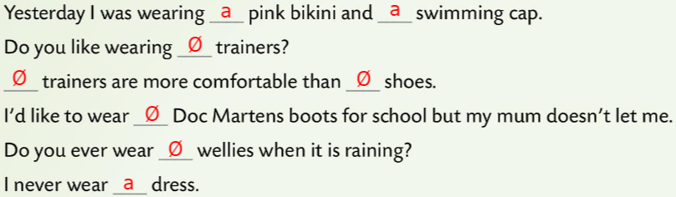
Workbook page 99.
Put in the correct article in Task 1.
Check.
Finish the sentences in Task 2.
Check in class.

